Slide 1
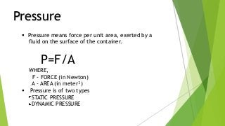

Slide 2
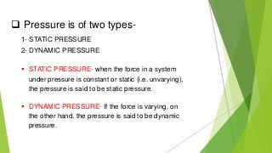

Slide 3
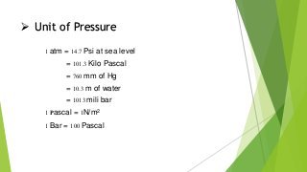

Slide 4
INDUSTRIAL INSTRUMENTATION

Slide 5
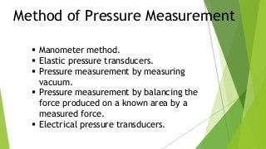

Slide 6
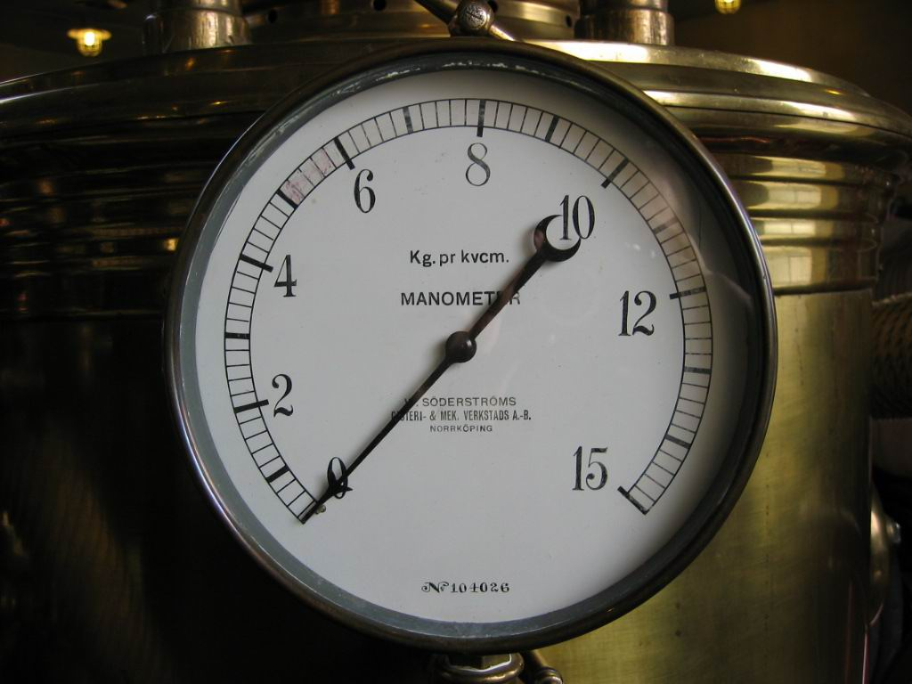
MANOMETERS
Definition – Manometers are self-balancing deflection type of instruments and have continuous rather than stepwise output.

Slide 7
Construction of Manometers:
Manometer bodies are usually made of Brass, Steel, Aluminum or Stainless Steel. Tubes are made of Pyrex. Scales are provided which read pressures in terms of mm of water in mm of Hg.
They can be provided in terms of kN/m^2 (kPa).
Ranges of Manometers are limited primarily on the low side by the ability to compare a liquid head to a scale reading and on the high side by the physical size of the manometer required to accommodate liquid head.

Slide 8
Manometers measures the unknown pressures by balancing against the gravitational force of a liquid.
Manometers are self balancing deflection type of instruments and have continuous rather than step-wise output.
Manometers are used as laboratories equipment.

Slide 9
Types of Manometers :
U-Tube Manometer
Well type Manometer
Inclined Tube Manometer
Ring Balance Manometer
Micromanometer

Slide 10
More Info :
Design Pressure: Generally used in near atmospheric applications, although the ﬂoat type metallic units are available up to 6000 PSIG (41 MPa).
Design Temperature: Function of seal ﬂuid, usually near ambient: − 70 to 150 °F ( − 57 to 66 ° C)
Sizes: Standard lengths from 6 to 140 in. (150 mm to 3.5 m)
Ranges: Minimum span with inclined or micro-manometers is 0 to 0.1 in. (0 to 2.5 mm); maximum span is 60 PSID (0.41 MPa)
Inaccuracy: Visual manometers can be read within 0.01 in. (0.2 mm); micro-manometers can be read within 0.002 in. (0.05 mm). Special manometers used as primary pressure standards can read within 0.0003 in. (0.001 mm)

Slide 11
COSTS :
Laboratory-quality, well-type, glass-tube manometer costs $100 to $150; laboratory- quality, glass U-tube, protected by polycarbonate shield costs about $250.
Laboratory- quality, glass tube micro-manometer also costs about $250; the cost of National Institutes of Standards and Technology traceable digital manometers with analog or digital outputs range from costs $1750 to $3000.

Slide 12
U-Tube Manometer:
The difference between the two columns of liquid is an indication of the pressure differential. There are no moving parts and no friction or inertia involved in the measurement; therefore, its accuracy is limited only by the visibility of the scale.
U-tube Manometers are available in lengths of 6 to 140 in. (150 mm to 35 m).
Depending on the density of the manometer ﬂuid used, they can read pressure spans from 1.25 to 410 kPa.
The commonly available manometer ﬁlling ﬂuid speciﬁc gravities are 0.827, 1.00, 1.75, 2.95, and 13.56. The Figure illustrates the most elementary type of manometer, the U-tube.

Slide 13
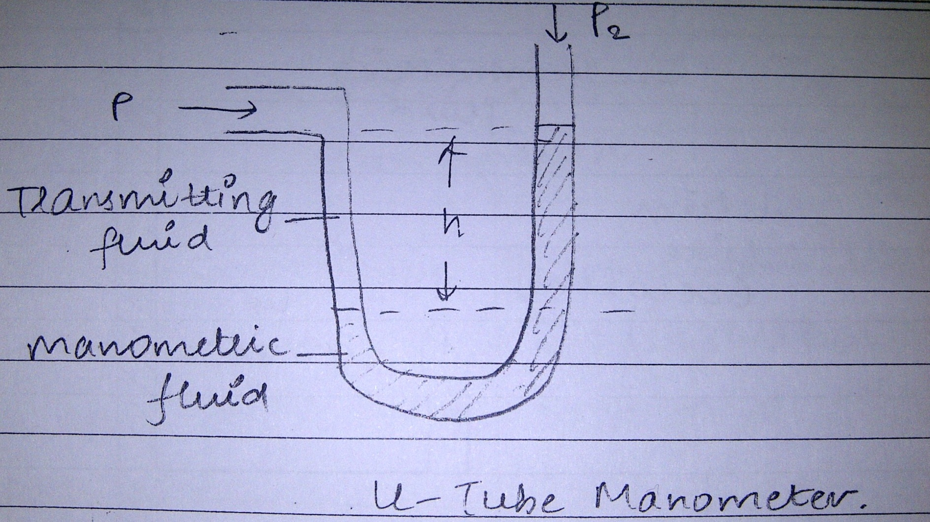

Slide 14
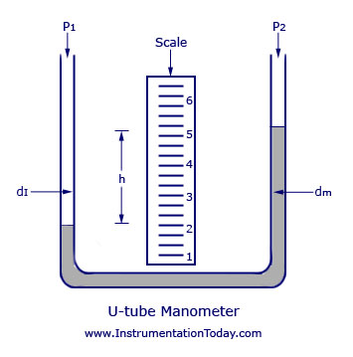
Image :

Slide 15
It is used for measurements of liquid or gas pressures. Manometers is filled with a manometeric fluid whose specific gravity is known.
The difference between the two limbs of a manometer is ‘h’. The pressure balance equation is given by :
P₁ + g.h.P_{f} = P₂ + g.h.P_{m}
where ‘g’ is the gravitational constant and P_{f} and P_{m} are specific density of manometeric fluid & transmitting fluid in kg/m³ .

Slide 17
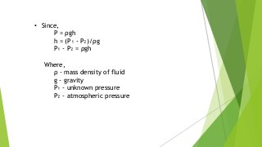

Slide 18
Formula :
The pressure difference in a vertical U-Tube manometer can be expressed as
P_{d} = γ h = ρ g h
Where,
P_{d} = Pressure
γ = Specific Weight of the fluid in the tube (kN/m³, lb/ft³ )
ρ = density (kg/m³, lb/ft³)
g = acceleration of gravity (9.81 m/s², 32.174 ft/s²)
h = liquid height (m, ft)
The specific weight of water, which is the most commonly used fluid in u-tube manometers
is 9.81 kN/m³ or 62.4 lb/ft³.

Slide 19
Well Type Manometer :
An easier-to-read scale can be attached to the Well manometer, when the liquid surface area on the high-pressure side is 1000 or more times greater than the area on the low pressure side.
Therefore, changes in d/p cause variation only in the column height on the low side, as shown in Figure, but leave the high side level practically unaffected.
Changes in well liquid level are compensated for by sliding the scale zero to match this level.
If a1 and a2 are the areas of the well and the capillary, and if (h1-h2) is the difference in height in the well due to the pressure difference (p1-p2) as shown, at balance, then
p1-p2 = dm.h (1+a2/a1)

Slide 20
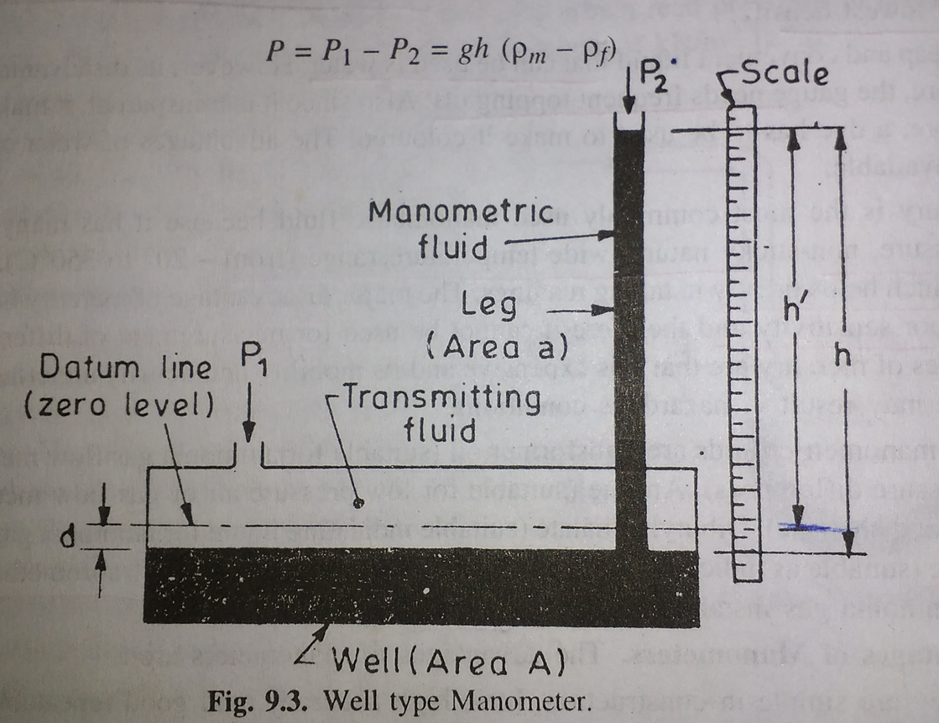

Slide 21
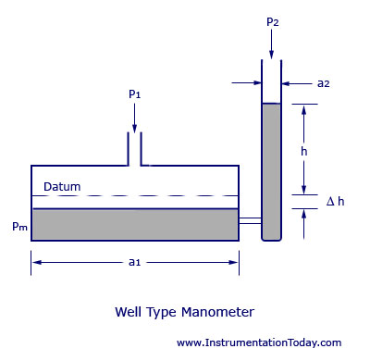
Image:

Slide 23
Problem
A mercury manometer reading at the top of a tower is 94.5 KPa and at the bottom is 76 cm Hg. Calculate the height of the tower if the density of air between top and bottom is 1.258 * 10⁻³ g / cm³.
Soluation:
76 cm Hg = 100 KPa
∆p = (101.325 – 94.5) * 10³ = 6.825x10 ³ Pa = ρ* g * H
= 1.258 * 9.8 .H H = 553.6 m

Slide 24
Inclined Tube Manometer :
If the vertical tube of a well manometer is laid down into an inclined, almost horizontal position, so that a slight change in process pressure will cause a large movement of liquid column.
The reading visibility will be improved.
Higher sensitivity than other type of Manometers.

Slide 25
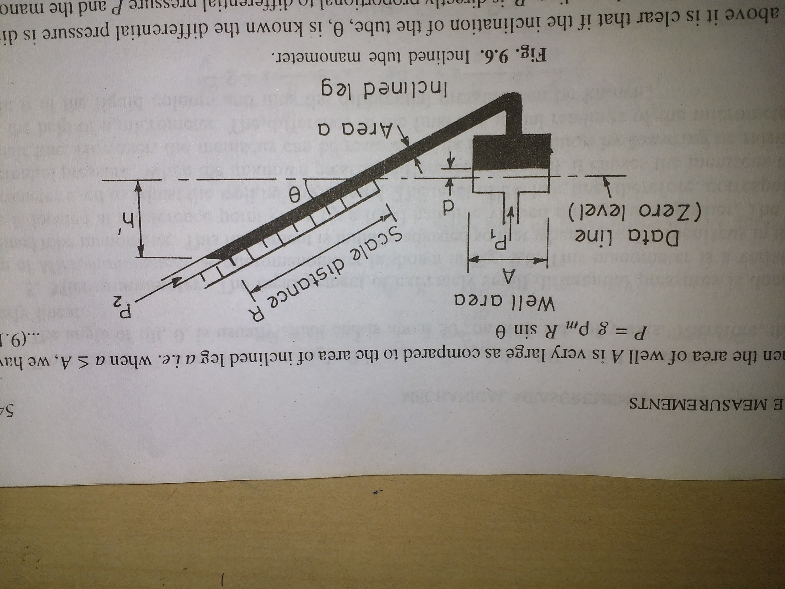

Slide 26
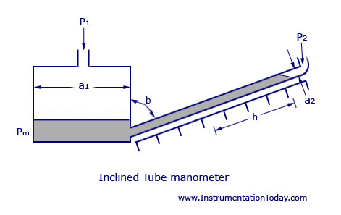
Image:

Slide 27
Formula:
The pressure difference in a inclined u-tube can be expressed as
P_{d} = γ h sin(θ)
Where,
θ = angle of column relative the horizontal plane
Inclining the tube manometer will increase the accuracy of the measurement.

Slide 28
Ring Balance Manometer :
A tubing ring formed in the vertical plane is pivoted at its central axis, and the pressure differential rotates this ring. The opposing torque is developed by a weight attached to the ring.
Depending on the design and the ﬁlling ﬂuid used, the minimum span for these units is 0.2 in. H 2 O (0.05 kPa) and the maximum span is 500 in. H 2 O (125 kPa).
Depending on the reference pressure used, it can detect absolute or near- atmospheric pressures.
At high pressures the ﬂexible connections at the sensing leads become a source of errors and require constant maintenance.

Slide 29
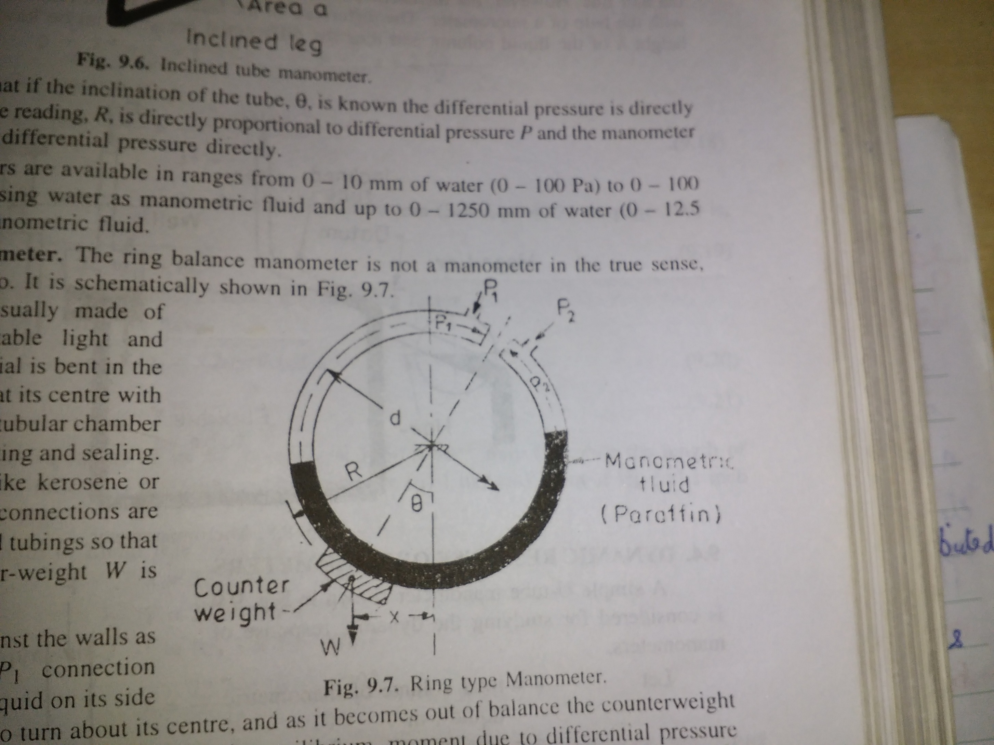

Slide 30
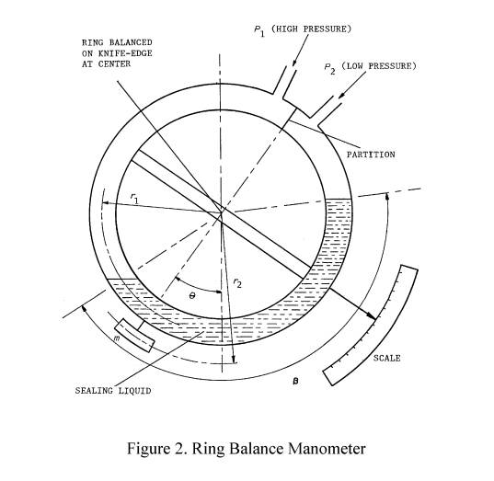
Image :

Slide 31
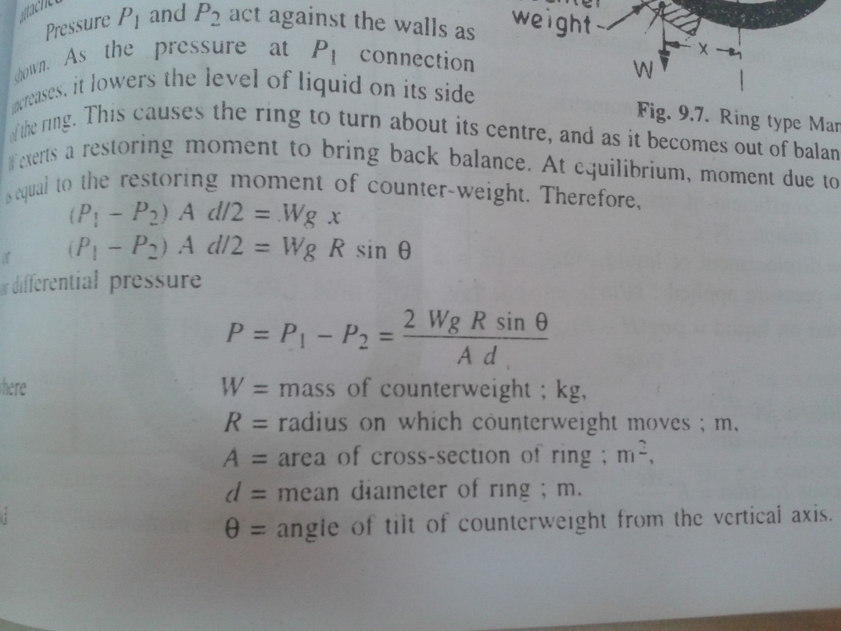
Formula :

Slide 32
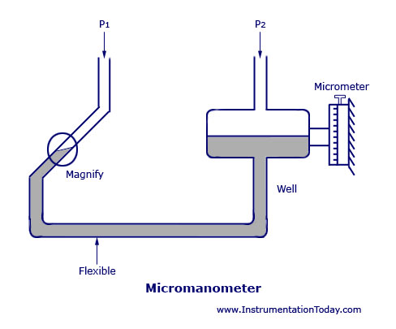
Micromanometer:
The measurement of extremely small differential pressures is done with the help of Micromanometers.
The Micromanometer is a variation of the incline tube manometer.

Slide 33
THANK YOU

